Slide 1
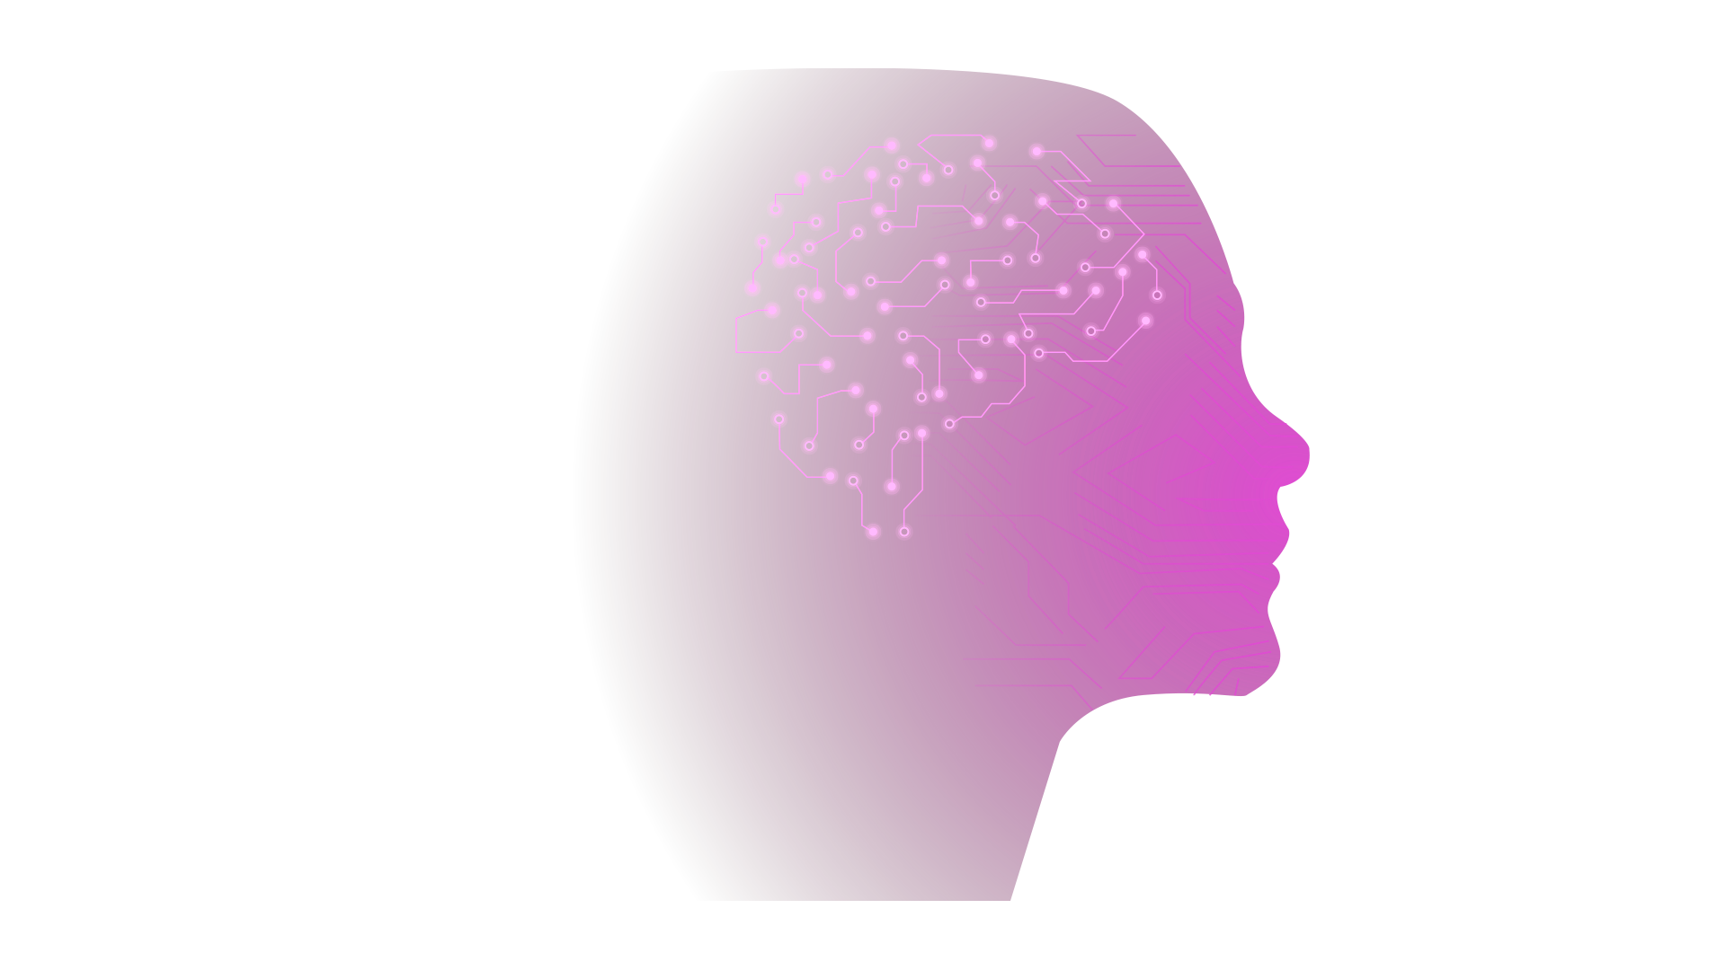
Custom Neural Network Framework
By Johnny Lee

Slide 2
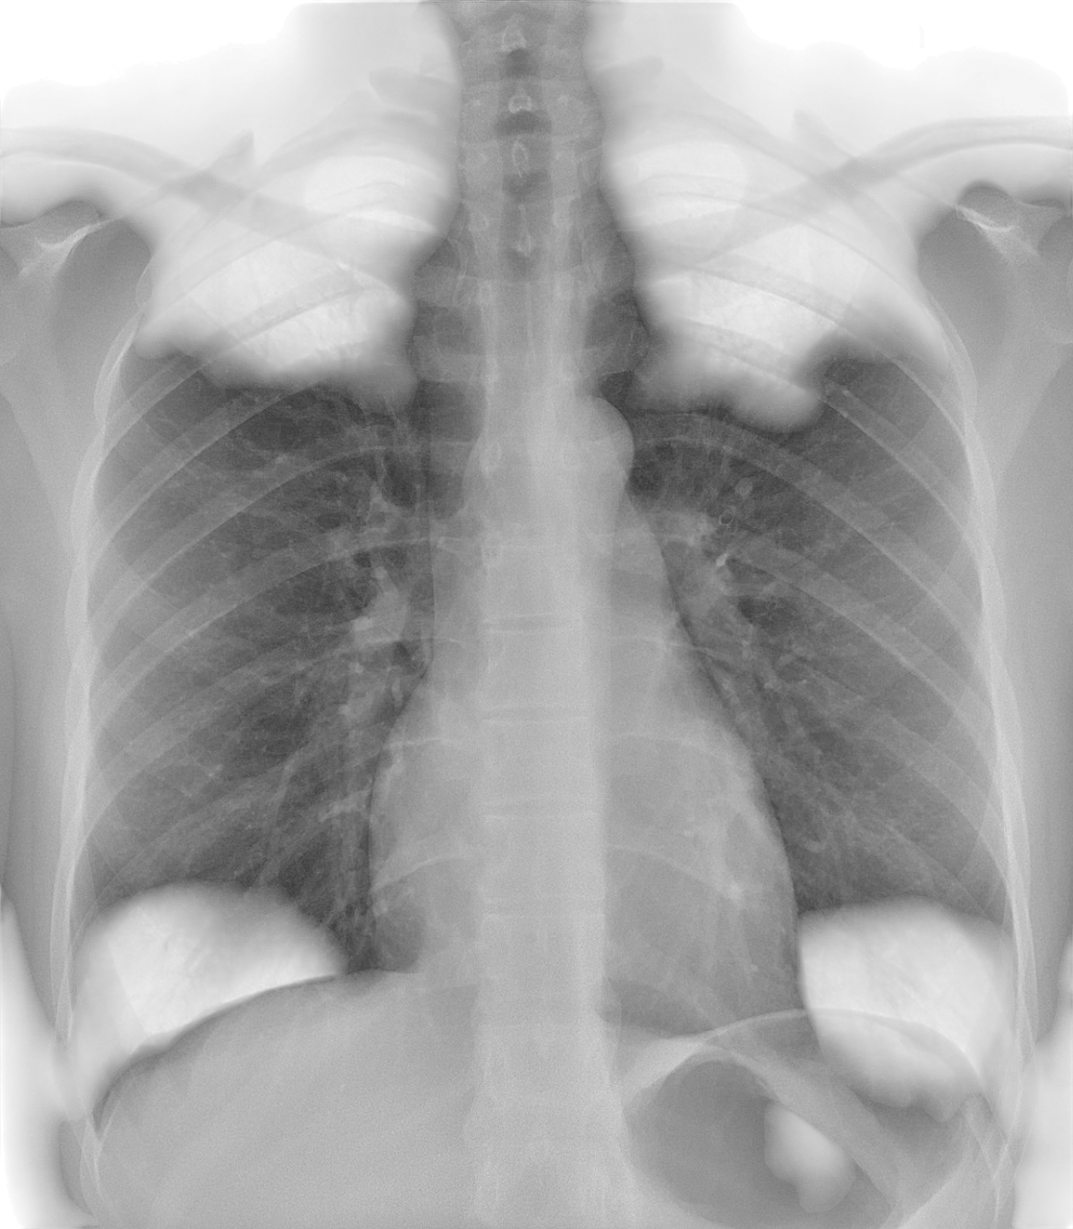
Why Neural Networks Matter for Health?
Neural Networks can act as radiologist assistants.
Example: trained a network on 19,500 chest X-rays, validated/tested on 8,500 (viral and bacterial pneumonia, COVID-19, TB, normal, and undiagnosed opaque lungs).
Achieved 94% accuracy in disease classification.
Notes:
One example of why neural networks are powerful is because they can support radiologists by acting as an extra set of eyes.
Currently they don’t replace radiologists but with future improvements they’ll likely handle some tasks independently.
For example, I trained a neural network on 19,500 chest X-rays and validated/tested it on another 8,500 images.
The dataset included six categories, which were: Viral pneumonia, bacterial pneumonia, COVID-19, tuberculosis, normal lungs, and lungs that were opaque, where opaque means the lungs were
not normal or in one of the 4 diseases categories.
The model achieved 94% accuracy at distinguishing between the 6 categories.
To put it simply: the network acts like a mini-radiologist, screening thousands of images in seconds and pointing out cases of concern.
The takeaway is that neural networks aren’t just abstract math, they have real practical applications across many domains.
Now, we will move onto what a neural network is.

Slide 3

What is a Neural Network?
A neural network is inspired by the human brain.
Both have neurons that take in signals, process them, and pass them on.
By connecting many neurons together, networks can learn complex patterns.
Notes:
A neural network is inspired by the human brain.
Formally, at its core, a neural network is a composite mathematical function, meaning one function feeds its output into another.
But instead of focusing on the math, lets think about neurons.
Just like in the brain, each neuron takes in signals from the ones before it, processes them, and passes a signal on to the next neuron, as shown in the diagram on the left.
By chaining together many of these neurons, the network can process information step by step. This allows it to learn and recognize very complex patterns from data.
So, you can think of a neural network in two ways:
Formally: a composite mathematical function, or,
Intuitively: a network of connected neurons passing signals and building up understanding. Now that we have the core concept of what a neural network is, let's look at the practical side: what kind of data we feed into it, and what kind of results we get out

Slide 4
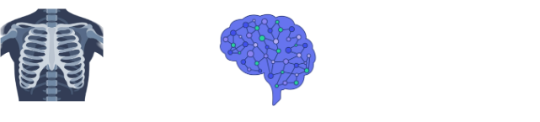

Inputs and Outputs of a Neural Network
Inputs
Task: Classification
Inputs (often called features) are the data given to the network to make a prediction.
Outputs
Task: Regression
Outputs are the prediction(s) produced by the network.
Notes:
The inputs to a neural network are called features. The key thing to remember is that a neural network only understands numbers.
So, no matter what our input is, say an image, a text file, or genetic data, we first need to convert it into a set of numerical values.
These features are the specific pieces of data the network will use to make its prediction.
There are two main types of predictions: classification and regression.
A great example of where classification can be used is analyzing medical images. Let's say we feed the network an X-ray image of a lung.
The network isn't seeing the picture like we do. Instead, each pixel in that X-ray is converted into a numerical value.
These thousands of pixel values become the input features.
The network then processes all these numbers, and for its output, it predicts a discrete category, such as healthy or pneumonia.
It's classifying the input into one of several predefined groups.
For regression, the network predicts a continuous number instead of a category.
A common example is predicting house prices: features like the number of bedrooms and bathrooms are used to estimate the value of the house.
So, the key difference is: Classification predicts what kind of thing it is, while Regression predicts how much of something there is.
Now that we understand the types of questions we can ask a neural network, let's walk through the simplest type of neural network.

Slide 5
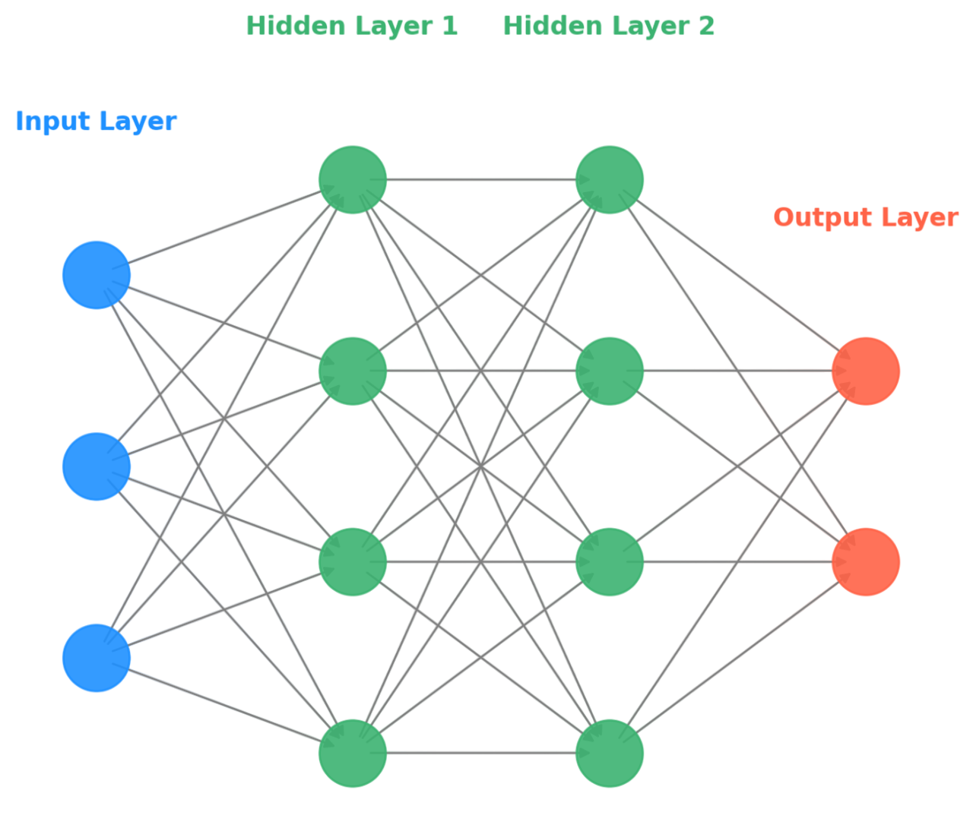
The Multilayer Perceptron (MLP)
Simplest type of neural network
Consists of layers of neurons (circles in the diagram) that process data from the input or previous layer and pass it to the next layer.
Architecture:
Input layer: takes in features.
Hidden layer(s): find patterns in the features.
Output layer: makes the prediction.
Notes:
The Multilayer Perceptron, or MLP, is the simplest type of neural network.
It’s made up of 3 kinds of layers: the input layer, the hidden layers, and the output layer. Each layer type contains neurons, which are the circles in the diagram.
As we discussed earlier, each neuron processes data and passes it along to the next layer.
The input layer, shown in blue, takes in the features. For example, pixel values from an X-ray or numbers like the number of bedrooms or bathrooms in a house.
Next are the hidden layers, which are shown in green. This is where the network finds patterns in the data. Early layers might detect simple things like edges, while deeper ones combine those earlier simple patterns into more complex patterns.
And finally, the output layer, shown in orange, produces the network’s prediction, like classifying an X-ray as pneumonia or estimating the price of a house.
Now that we’ve seen the overall structure of an MLP, let’s zoom in on a single neuron to see how the math inside one works.

Slide 6
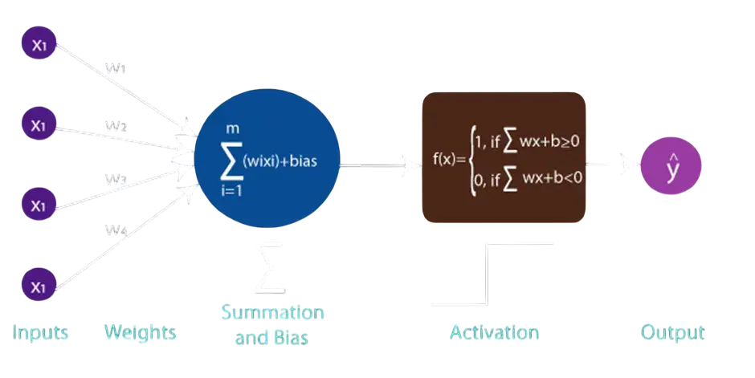
Inside a Neuron
A neuron receives the output from each neuron in the previous layer as input.
Each input has a weight, which represents its importance.
The neuron adds these weighted inputs together.
A bias term is added to shift the result.
The result passes through an activation function, which decides if the neuron fires and introduces non-linearity to the network.
Notes:
A neuron receives the output from each neuron in the previous layer as input.
Each input has a weight associated to it that represents its importance.
The neuron than computes a weighted sum with the weight/input pairs, this operation is called the dot product.
A dot product is used as it measures how much the input pattern aligns with the neuron's weights.
Basically, the neuron is checking does the input line up with the pattern I’m tuned to detect.
If the input and weights line up, the output is a large positive number, if they are unrelated its near 0, and if they are opposite, it’s a negative number.
A bias term is added to shift the weighted sum, allowing the neuron to activate at different thresholds instead of only when the weighted sum is above 0.
Finally, the output is passed to an activation function. This allows the network to learn virtually any pattern from the data.
Without these activations, the whole network would just be a linear model and wouldn’t be able to learn these complicated non-linear patterns.
In this example we are using a basic activation called a ReLU which sets negative output to 0 and keeps the positive output the exact same. Now that we’ve seen how a neuron processes inputs, let’s look at how the entire network learns from data.

Slide 7
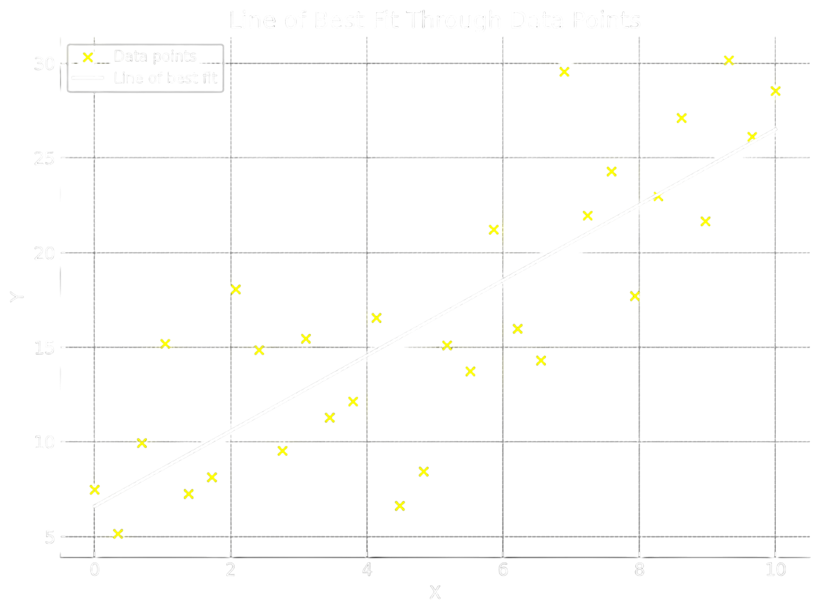
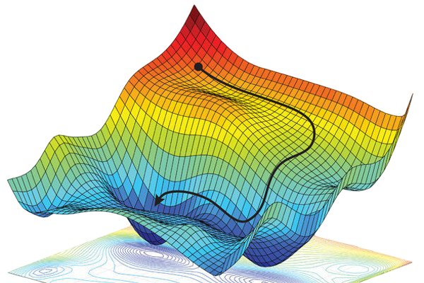
How Neural Networks learn
During training, predictions are passed to a loss function, which measures how wrong they are.
The network learns by adjusting the weights and biases to minimize this loss through a process called backpropagation.
This process is identical to finding a line of best fit in 2D regression.
It can also be pictured as a ball rolling downhill, settling at the lowest point of error.
Notes:
During training, a networks predictions are passed to a loss function, which tells the network how wrong it was.
The network learns by adjusting its weights and biases to minimize this loss through a process called backpropagation.
This process is identical to finding a line of best fit in 2D data. We find the line of best fit by making sure the line is as close as possible to all the data points. (aka minimize the SSE in the y direction)
It can also be thought of as a ball rolling down a bumpy hill. At the start of training the ball is at the top of the hill signifying high loss as the predictions are bad.
As the network trains the ball starts to roll down the hill, telling us the loss is getting lower and that predictions are getting better,
The ball continues to roll down the hill until the ball settles in a pocket at the bottom, where it can’t escape or roll out of.
Now that we know what a neural network is and how it learns. Let’s look at a special kind of neural network called a CNN designed to look at images.

Slide 8
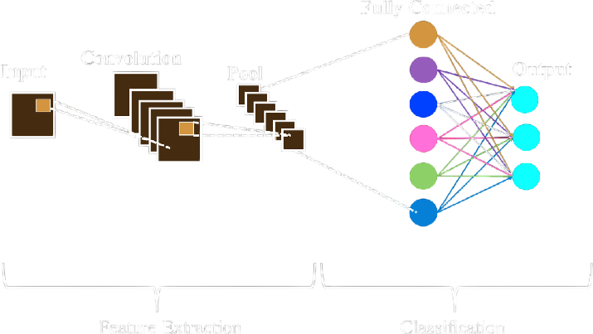
What is a Convolutional Neural Network (CNN)
CNNs are a specialized neural network for image, video, and audio data.
They scan small patches of data at a time, which helps them detect edges, shapes, and patterns efficiently.
The scanners are called filters (or kernels) and each one of them learns a pattern from the data.
Notes:
A CNN is a specialized neural network for image, video, and audio data.
Unlike neurons in MLPs that take in an entire layer of neurons as input, each filter scans a small patch of the data at a time, then does a weighted sum.
The filters repeat the process by sliding across the entire image, and learns features like edges, textures, shapes, and patterns.
These scanners are called filters or kernels, and each one of them learns a pattern from the data.
The diagram in the top right is the structure of a CNN. First, the convolutional layers scan the image with filters to and produce outputs that represent the patterns they’ve found in the image.
The pooling layer reduces the amount of information the network must handle, by only keeping the most important features.
This makes the network faster and helps it recognize patterns when images are shifted a little.
Finally, you have the fully connected layers, just like in the MLP neural network we saw earlier.
These layers take the features learned by the convolutional layers and combine them to make a final prediction.
Most often CNNs are used for classification, but they can also be used for regression.
Now that we know how a CNN works at a high level. I can tell you about the framework that I built.

Slide 9
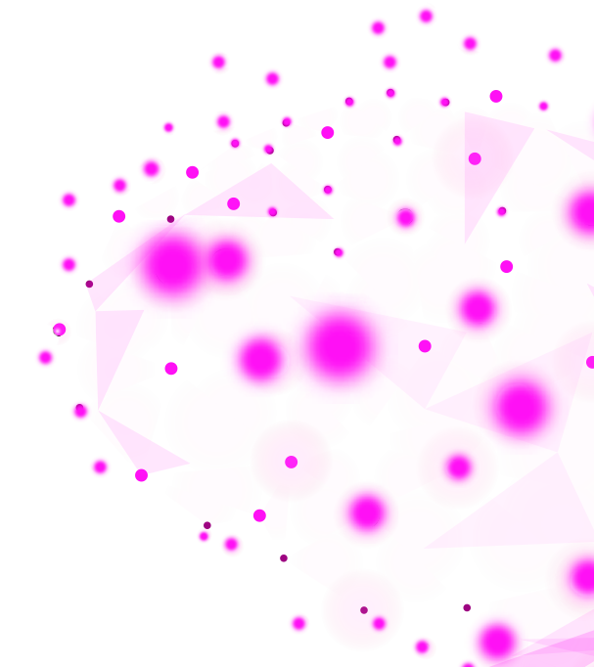
Training Features of The Framework
Supports both tabular and image data.
Handles categorical and numerical inputs.
Built-in data loaders for easy input.
Provides data splitters to divide data into training, testing, and validation sets.
Provides data transformers to normalize, scale, or resize data.
Supports multiple layers, losses, and activations.
Supports classification and regression tasks.
Notes:
First, I’ll explain what training a neural network means. Training simply means giving the network a dataset and letting it adjust its weights and biases to learn patterns from the data.
The framework supports training on both tabular and image data.
It handles both categorical and numerical input.
It has built in data loaders for easy input.
It provides data splitters to divide the data into training, testing, and validation sets.
The training set it used to teach the network, it’s the data the network learns from.
The validation set is used during training to monitor how well the model performs on unseen data, showing whether the model is learning meaningful patterns or just memorizing the training data.
The testing set is used after training as a final evaluation to see if the model generalized the training data and learned meaningful patterns or just memorized the training data.
The framework also provides data transformers/scalers to normalize, scale, and/or resize the data. Resizing is specifically for image data.
It also supports multiple layer, loss, and activation types.
Finally, it supports both classification and regression.
It also has other training features, but these are just the main ones.
Now that we’ve covered the main training features, let’s look at how the framework helps you monitor and evaluate training.

Slide 10
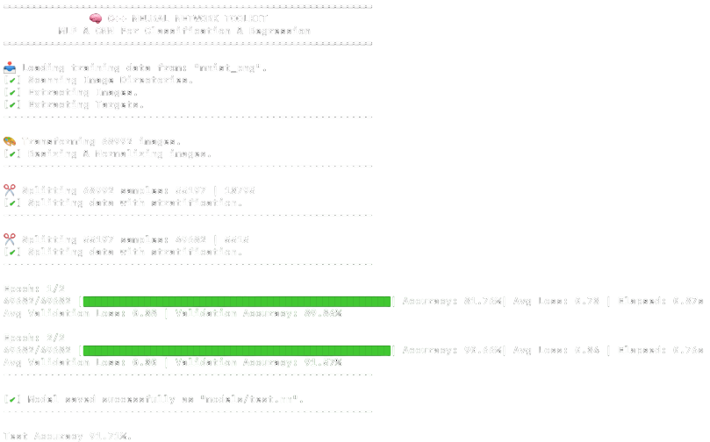
Testing & Monitoring Features of The Framework
Monitoring Features:
Command-line interface (CLI) shows each step of data preparation and training.
Progress bar displaying progress through each epoch.
Tracks running loss, evaluation metric, and time per epoch in seconds.
Prints validation loss and performance metric after each epoch.
Early stopping halts training if validation performance stops improving and keeps the best model.
Testing Features:
Easily evaluate a trained network on a test set.
Supports multiple performance metrics for classification and regression.
Notes:
The framework also provides features to monitor training and test the network.
First, I will begin with the monitoring tools.
On the left, you can see the key monitoring features. The interface prints every step:
Data loading, transformation, splitting then training.
As the model trains, you can follow along with the green progress bar.
This shows how far we are in the current epoch and gives a live update on the running average loss, how much time has passed, and our main performance metric, which for this example is accuracy.
An epoch just means the network trained on the entire training data set 1 time.
At the end of each epoch the validation loss and performance metric are printed, to see if the model is learning useful patterns that generalize to unseen data.
Once the model finishes training, we can save it and evaluate it on a test set with multiple performance evaluation metrics depending on the task type, for example regression or classification.
Here we used accuracy. Now that we’ve seen how training is monitored and tested, let’s move on to how data flows through the network.

Slide 11
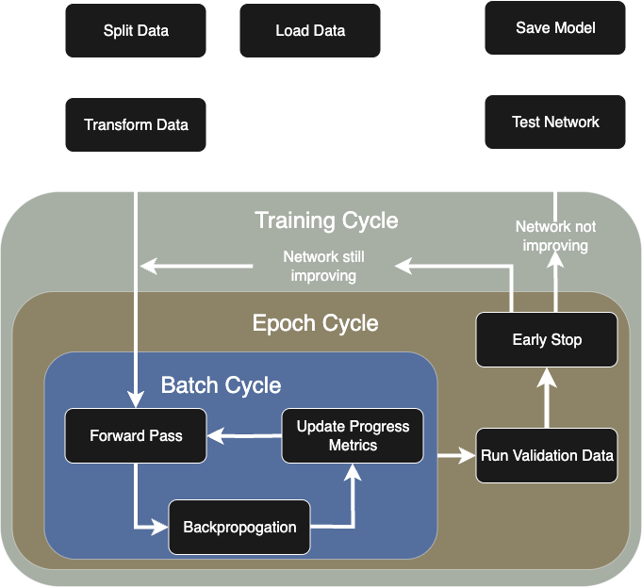
Data Flow Through A Neural Network
Training data is split into batches, and an epoch ends once all batches are processed.
After each epoch we run validation. If the network is not improving, we test and save the model. If it is improving, we continue training for another epoch.
Notes:
For space I have left out defining the network. But the first thing you must do is define your model architecture and loss function.
Then we load in the data, split it, and transform it for training.
Next, we pass the transformed data to the network to train on. The training cycle starts by splitting the data into batches, which improves learning and computational efficiency
Each batch goes through a forward pass, which is where the network makes predictions.
The network then learns from those predictions through backpropagation.
At this point, a batch of samples has completed a full pass through the network, where the model made predictions and updated its weights based on the batch.
After that, the progress metrics are updated, such as the loss, the performance metric, and the time.
This cycle repeats until all batches in the training set have been processed, which completes one epoch.
At the end of each epoch, we run a validation to check whether the network is improving.
If the network is still improving, we start another epoch to see if it can learn more. If not, we stop training the model as it’s not able to learn anymore information.
After training, we test the model and save it. Now that we’ve seen how data flows through the framework. Let’s see how to speed this up with GPU computing.

Slide 12

What is GPU Computing
GPUs perform thousands of small calculations all in parallel.
CPUs perform only a limited number of calculations in parallel.
Parallelizable: grading 100 exams with 100 graders.
Not parallelizable: baking a cake (must be done step by step).
Notes:
Central Processing Units (or CPUs) and Graphics Processing Units (or GPUs) both have cores that can run work in parallel.
Each CPU core is big and general-purpose. It can handle complex tasks, run your operating system, and manage all parts of your computer.
Each GPU core is much simpler. It’s, specialized for doing math operations, but there are thousands of them.
CPUs typically have 4-8 cores, so they can do about 4-8 tasks in parallel.
GPUs typically have 2000-5000 cores, so they can do 2000-5000 simple math operations in parallel.
GPUs are powerful, but only for tasks that can be broken down into many simple, independent math problems that can all be solved in parallel.
Some tasks just don’t work this way.
An example of a task that can be parallelized is grading 100 exams with 100 graders.
Each exam grade doesn’t depend on any other exam grade, so we can have each person mark 1 exam in parallel.
An example of a task that can’t be parallelized is baking a cake.
If a baking a cake has 3 steps: 1) mix the ingredients, 2) bake the cake, 3) frost the cake. Each step depends on the step before it being completed, you cannot frost a cake that hasn’t been baked yet. Now that we understand when GPUs are useful, let’s look at how GPU computing is applied to neural networks.

Slide 13
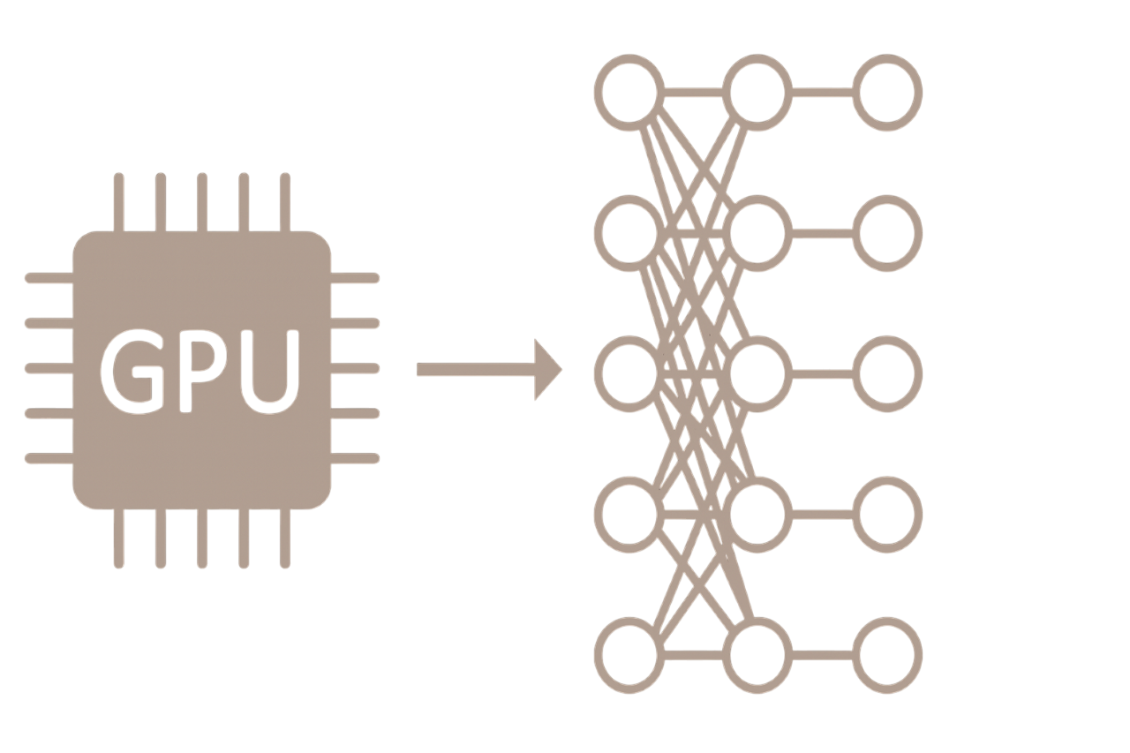
GPU Computing for Neural Networks
Neural networks have many independent neurons in each layer.
Each neuron can be computed in parallel.
But the layers themselves must be computed sequentially as each layer's output is another layer's input.
Notes:
Neural networks are a perfect match for GPUs.
Within a single layer, every neuron is independent, so the GPU can compute each neuron in parallel.
But the layers themselves must be computed sequentially. This is because each layer’s output is the input to another layer
Now that we’ve seen why neural networks fit so well with GPUs, let me show you how my framework takes advantage of GPU computing.

Slide 14
How the Framework Uses GPU Computing
Forward pass for each layer is GPU accelerated by computing each neuron simultaneously.
Backpropagation is also GPU-accelerated, with neurons updated in parallel.
This parallelism massively speeds up the training process.
GPU Training (65s/epoch)
CPU Training (10,011s/epoch)
GPU training is 154x faster than the CPU (~15,400% faster)
Notes:
In my framework I use GPU computing in the two most important parts of training: the forward pass and backpropagation.
During the forward pass, the network makes predictions. Since each neuron in a layer is independent, the GPU can compute them in parallel.
I also use GPU-acceleration in backpropagation, where the network learns as again each neuron in a layer is independent, therefore we can update them in parallel.
Together, these are by far the most computationally expensive steps in training. By moving them to the GPU, the training process becomes massively faster than it would be on the CPU alone.
On the left we compare GPU vs CPU training times. I trained a small network to classify lung X-rays into two categories: pneumonia and normal.
On the GPU it took 65 seconds per epoch.
While on the CPU it took 10011 seconds or 2 hours and 47 minutes per epoch. Making the GPU 154x faster then the CPU.
The takeaway is GPU computing isn’t optional, it’s essential for practical deep learning. Now that we’ve seen how GPUs speed up training, let’s look at how CNNs are actually applied in practice.

Slide 15
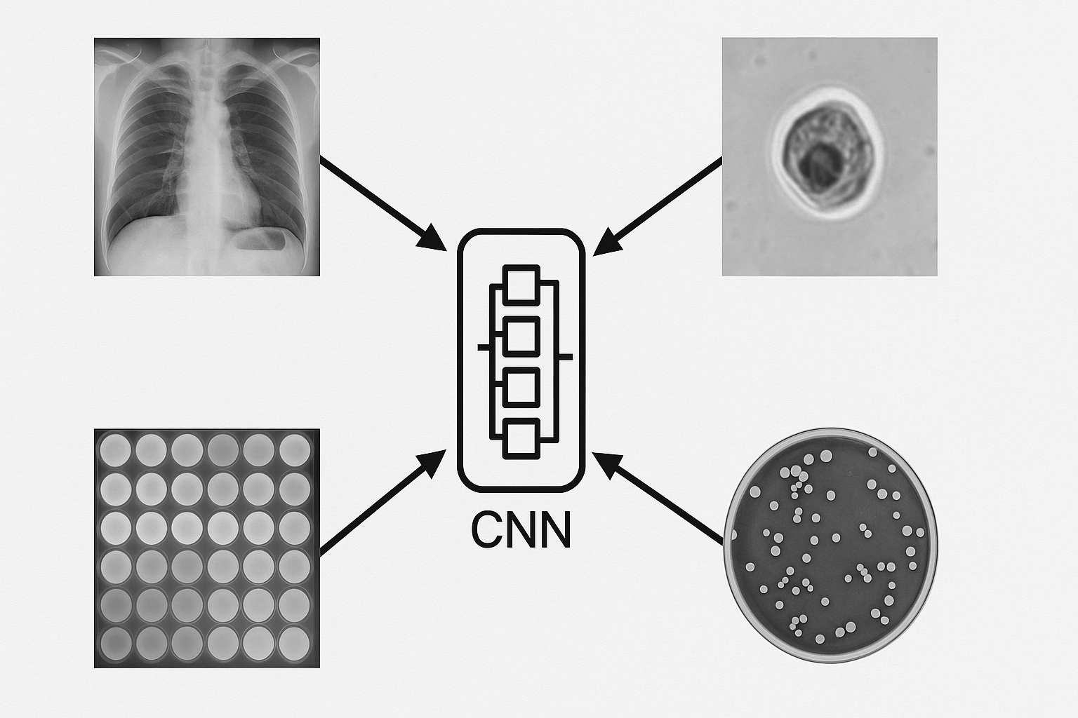
Applications of CNNs in Health and Microbiology
Medical Imaging: detect diseases from X-rays, CT scans, MRI scans, and pathology slides.
Diagnostics: analyze lab results, ELISA plate images, and gel electrophoresis (including Western blot).
Microbiology: classify bacterial/viral colonies, identify healthy vs abnormal cells in microscopy.
Surveillance: large-scale outbreak detection and pattern recognition.
Notes:
One application of CNNs which I’ve mentioned is disease diagnoses from medical imaging such as X-rays, CT scans, MRI scans, and pathology slides (tissues samples viewed under a microscope, often used to diagnose cancers or infections).
Another application is diagnostics.
CNNs can be used on ELISA images. They can either measure colour intensity like a virtual plate reader, or they can be trained end-to-end to classify wells directly as positive or negative from the images.
CNNs can be used to interpret gel electrophoresis (and Western blot) images. Detecting faint bands, quantifying their intensity, and identifying patterns linked to mutations or disease.
Microbiology use cases: CNNs can analyze petri dish images to automatically detect, count, and classify bacterial or viral colonies based on shape, size, colour, and texture.
CNNS can differentiate between healthy and abnormal cells from microscopy images. Where abnormal means infected, cancerous, or some other disease.
Surveillance use cases:
CNNs can support outbreak detection by rapidly screening large numbers of lab samples or images to find anomalies. This includes not just flagging positive cases, but recognizing geographic or temporal (pattern over time) clusters, providing early warning
signs of an outbreak that humans might otherwise miss.
Point of care use cases:
Another powerful application of CNNs for diagnostics is the automated analysis of rapid test kits.
We can train a model to recognize the visual patterns of a positive or negative result.
The user simply takes a picture of their test, and an app on their phone, running our model, can analyze the image.
The model will classify the result as positive or negative and give a probability to show how confident it is in its prediction.
This helps reduce human error when a result might be hard to read.
The take-away is this: In healthcare, if a problem can be visualized, a CNN can be trained to help solve it.
Now that we’ve seen the applications of CNNs in healthcare, let’s move on to future improvements I plan to make to my framework.
FOR ME:
ELISA plates have wells that are coated with antigen/antibody. If the target (antigen/antibody of disease) is present, binding occurs. A detection system produces a colour change.
Strong colour = lots of binding so high concentration of target, weak color = low binding so low concentration of target. (Opposites always bind so if we coat with anti-body then we re looking for sample antigens (parts of the disease))
Gel Electrophoresis:
Separates DNA, RNA, or proteins by size using an electric field. Molecules move through the gel, smaller molecules move further through the gel, bigger molecules experience more resistance from the gel, and therefore they end up closer to the starting point.
Molecules on the gel appear as bands. Band intensity tells us the concentration of molecules at a certain spot on the gel.
Mutations or disease can alter these band patterns (different band sizes, missing/extra bands, or different intensities).
Colonies:
Colonies grow in Petri dishes when a single bacterium, or virus replicates many times. Each dot on the dish is a colony.
Each colony can look different through shape, size, colour, and texture varying depending on the species.

Slide 16
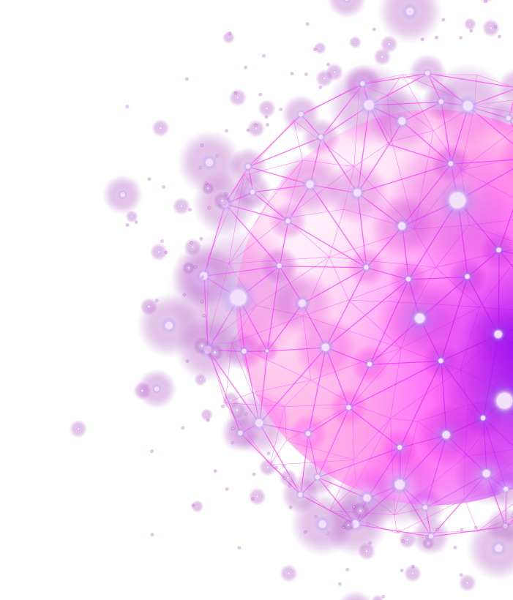
Future Improvements
Improve GPU acceleration.
Reduce memory usage across framework.
Expanded library of activations and losses.
Support for advanced blocks.
More Data scalars/transformers.
Layer normalization.
Python interface for easier usage.

Slide 17

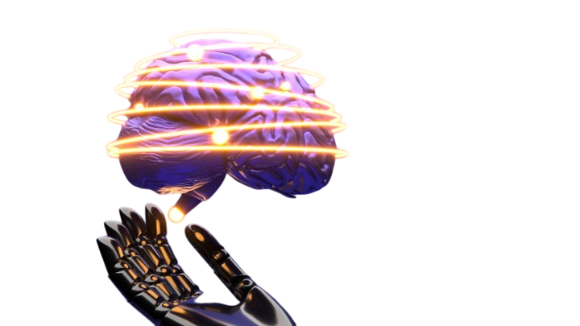
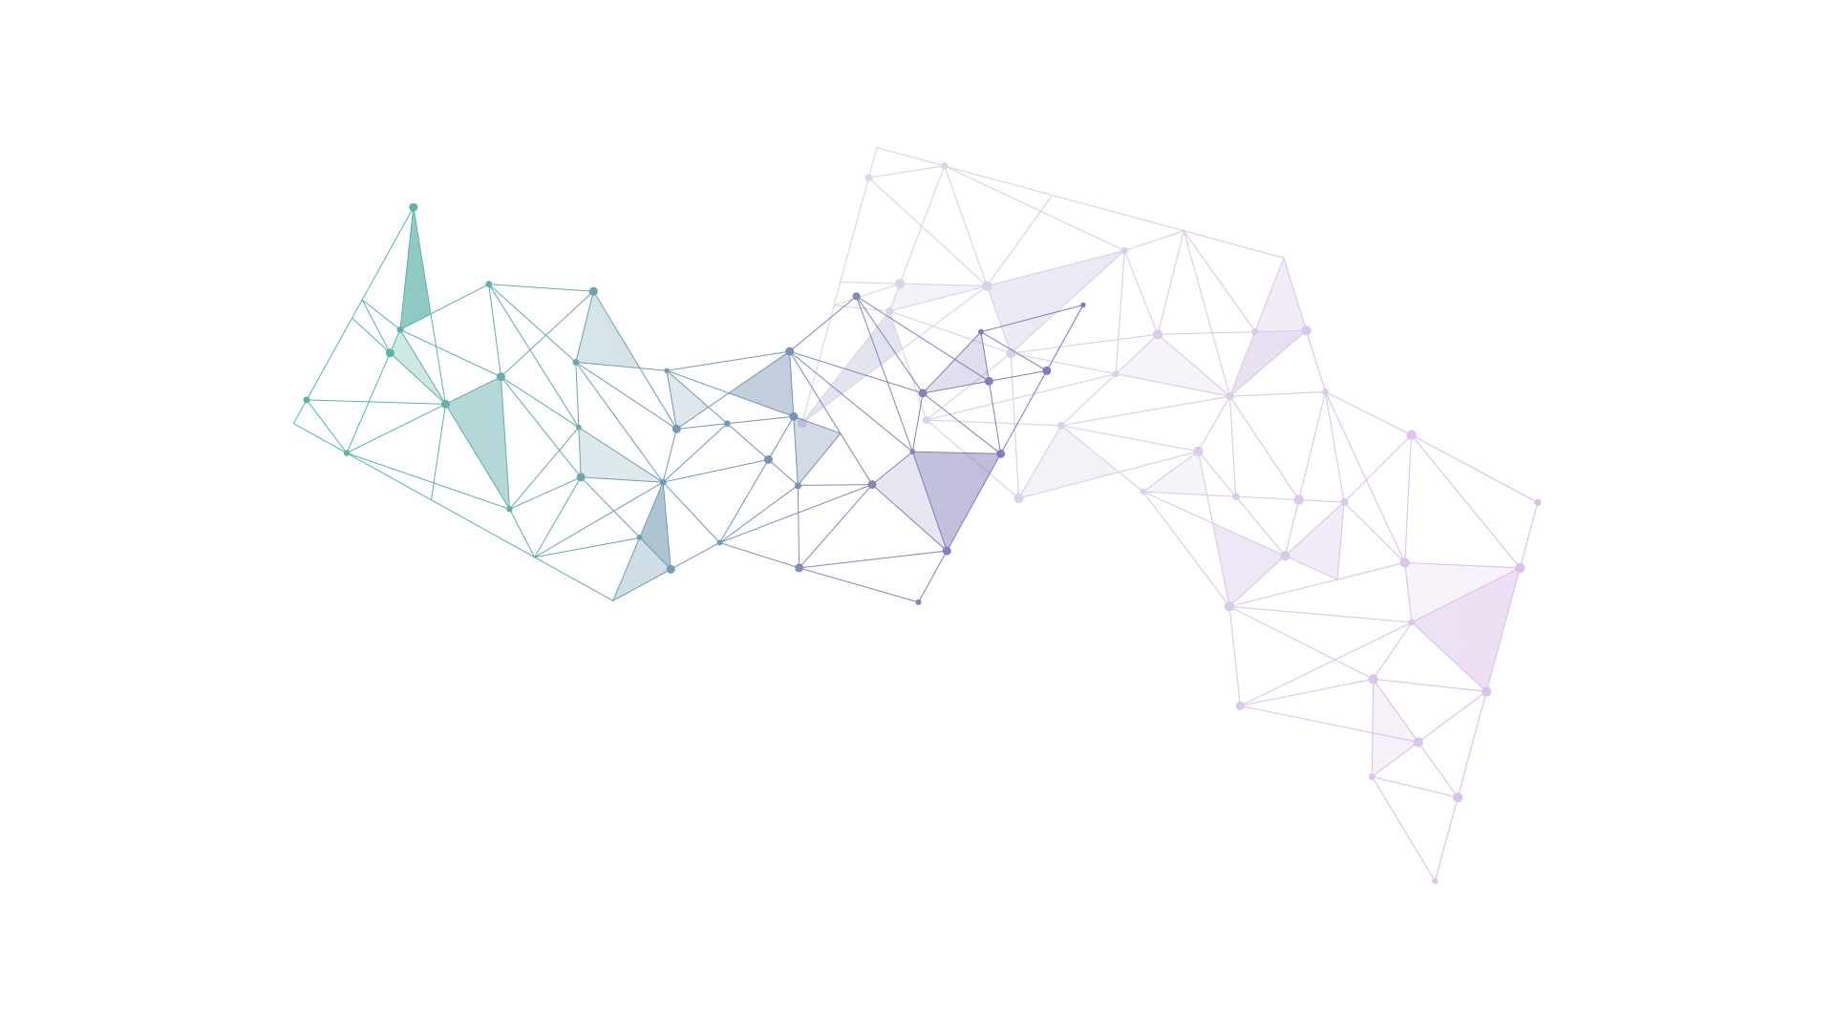
Demo:
End-to-End Pipeline
(watch it train & run in real-time)

Slide 18
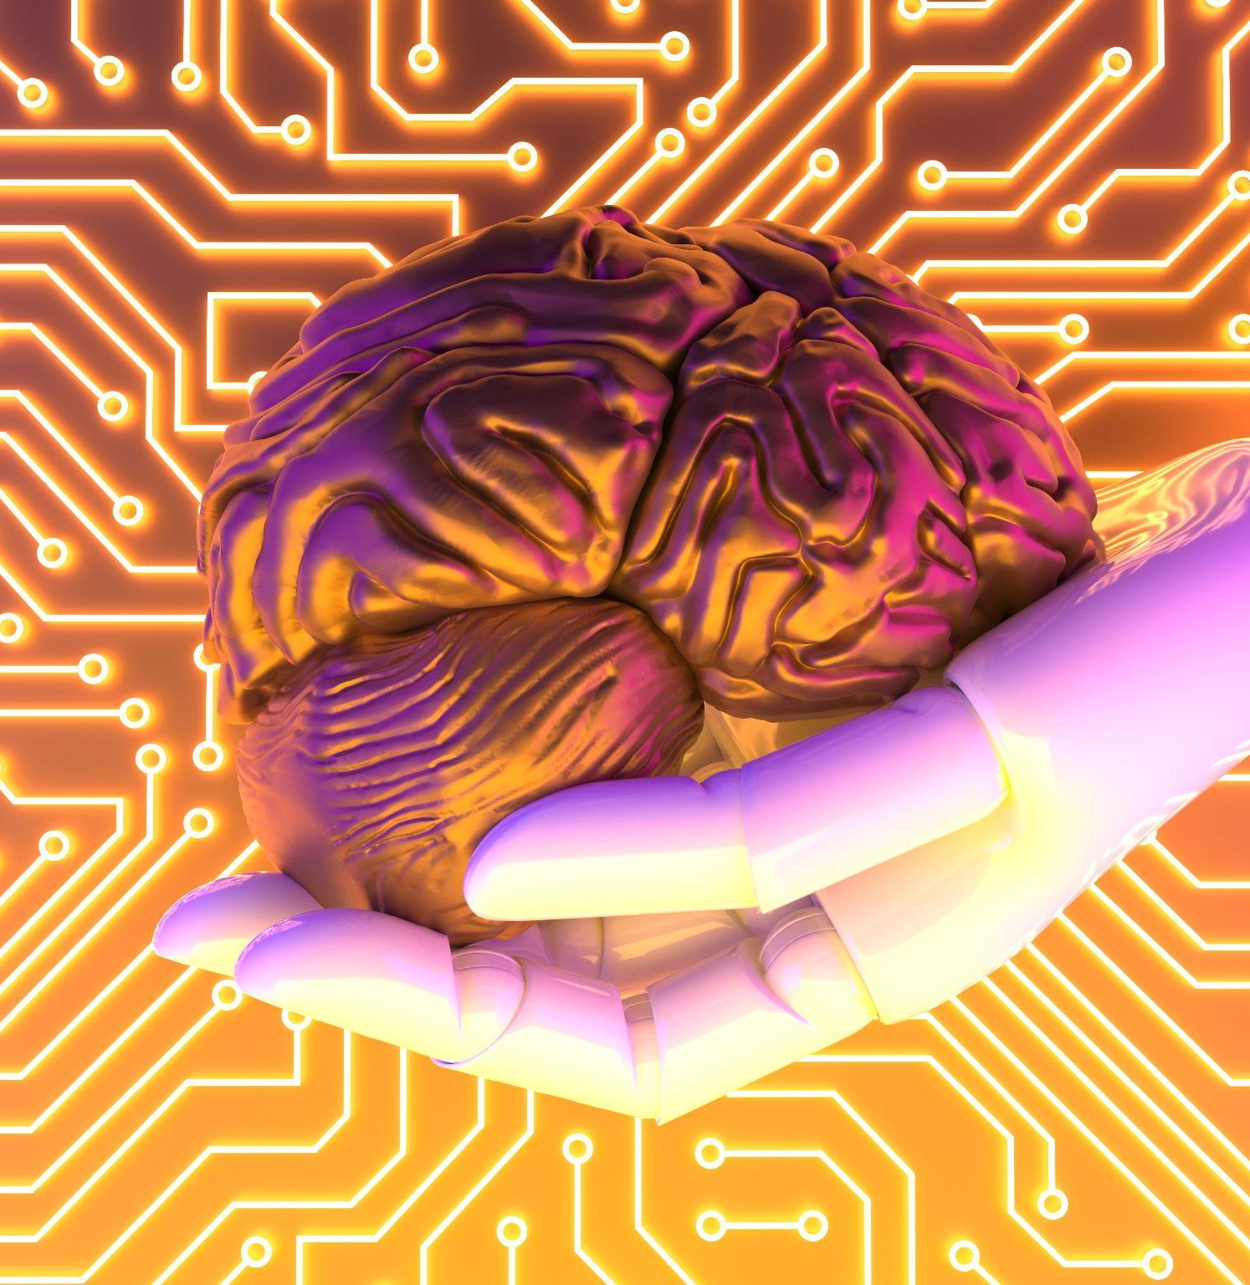
“A day working with me”
Thank you
Code Available here

